Slide 1
SCSE 1224 Advance Programming
Topic - Class Relationships
Lecture 19
Based on Slides of Dr. Norazah Yusof

Slide 2
Relationships among Classes
Association
Aggregation
Composition
Inheritance

Slide 3
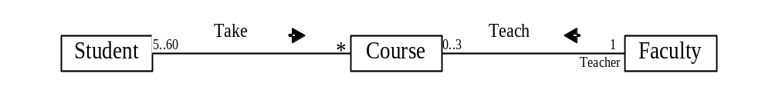
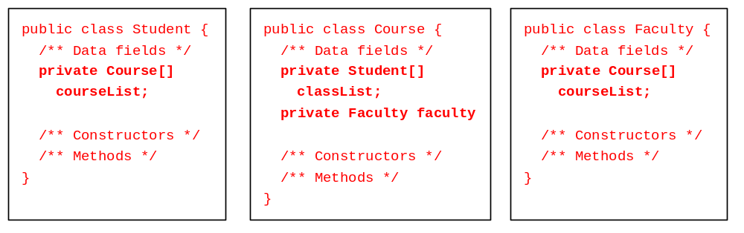
Association
Association represents a general binary relationship that describes an activity between two classes.
An association is usually represented as a data field in the class.

Slide 4
Association
Example: Student register course.
The arrow is optional and specifies navigability.
No arrow implies bidirectional navigability
register(Course)
5..60
*
Student
Course

Slide 5
Association
An association is usually represented as a data field in the class.
Student
Course
name : String
matrix : String
courseList : Course[]
numOfStudent : int
name : String
code : String
section : int
registerCourse(Course)
5..60
*
+ Student(String, String,
String)
+ getName() : String
+ getMatrix(): String
+ getNumOfStudent(): int
+ registerCourse(Course)
: void
+ printAllInfo():void
+ Course(String, String,
int)
+ getName() : String
public class Course
{/*attributes*/
/*methods*/}
public class Student
{ /*attributes*/
private Course[] courseList;
/*methods*/}

Slide 6
Association
The relationship allows objects to call methods in other objects.
Student
Course
name : String
matrix : String
courseList : Course[]
numOfStudent : int
name : String
code : String
section : int
registerCourse(Course)
5..60
*
+ Student(String, String,
String)
+ getName() : String
+ getMatrix(): String
+ getNumOfStudent(): int
+ registerCourse(Course)
: void
+ printAllInfo():void
+ Course(String, String,
int)
+ getName() : String
public class Course
{/*attributes*/
/*methods*/}
public class Student
{ /*attributes*/
private Course[] courseList;
/*methods*/}

Slide 7
Association
This is the same as an object sending another object a message.
Therefore, it is implemented as object references.
Student
Course
name : String
matrix : String
courseList : Course[]
numOfStudent : int
name : String
code : String
section : int
registerCourse(Course)
5..60
*
+ Student(String, String,
String)
+ getName() : String
+ getMatrix(): String
+ getNumOfStudent(): int
+ registerCourse(Course)
: void
+ printAllInfo():void
+ Course(String, String,
int)
+ getName() : String

Slide 8
Association Example 1: Student register Course
1 2 3 4 5 6 7 8 9 10 11 12 13 14 15 16 17 18 19 20 21 | import java.util.*; public class TestAssociate{ public static void main(String args[]){ Course cs1 = new Course("OOP","SCP3103",3); Course cs2 = new Course("TP1","SCJ1013",3); Course cs3 = new Course("TP2","SCJ1213",3); Course cs4 = new Course("KP","SCP2113",3); Student s1 = new Student ("ALI","AC1234","2SCS"); s1.registerCourse(cs1); s1.registerCourse(cs2); s1.printAllInfo(); System.out.println(); Student s2 = new Student ("AHMAD","AC1122","3SCK"); s2.registerCourse(cs1); s2.registerCourse(cs3); s2.registerCourse(cs4); s2.printAllInfo(); } }

Slide 9
Association Example 1: Student register Course
(Student class)
1 2 3 4 5 6 7 8 9 10 11 12 13 14 15 16 17 18 19 | public class Student { private String name; private String matrix; private Course[] courseList; private int numOfCourse; public Student(String n,String m,String c){ name=n; matrix=m; courseList = new Course[10]; } public String getName() { return name; } public String getMatrix() { return matrix; }
//showing association
//showing association

Slide 10
Association Example 1: Student register Course
(Student class – cont.)
//showing association
21 22 23 24 25 26 27 28 29 30 31 32 33 34 35 36 37 38 39 | public void registerCourse(Course cs) { courseList[numOfCourse] = cs; numOfCourse++; } public int getNumOfCourse() { return numOfCourse; } public void printAllInfo() { System.out.println("\nSTUDENT NAME :"+name); System.out.println("NUMBER OF SUBJECT(s) TAKEN :" + numOfCourse); System.out.println("LIST OF SUBJECT(s) TAKEN :"); for(int i=0;i<numOfCourse;i++) { Course s=(Course)courseList[i]; System.out.println((i+1) + ". " + s.getName()); } } }

Slide 11
Association Example 1: Student register Course
(Course class)
1 2 3 4 5 6 7 8 9 10 11 12 13 14 | public class Course { private String name; private String code; private int section; public Course(String n,String c,int s){ name = n; code = c; section =s; } public String getName() { return name; } }

Slide 12
Association Example 2: Lecturer teach Course
Write the classes and test the classes to show association relationships among them.
Lecturer
Course
name : String
courseList : Course[]
numOfCourse : int
name : String
code : String
section : int
Teach(Course)
0..3
1
+ Lecturer (String)
+ getName() : String
+ getNumOfCourse(): int
+ teach(Course): void
+ printAllInfo():void
+ Course(String, String,
int)
+ getName() : String
public class Course
{/*attributes*/
/*methods*/}
public class Lecturer
{ /*attributes*/
private Course[] courseList;
/*methods*/}

Slide 13
Association Example 3: Bidirectional Relationship Student register Course and Course add Students
Student
name : String
matrix : String
courseList : Course[]
numOfStudent : int
Course
register(Course)
name : String
code : String
section : int
stuList: Student[]
5..60
*
0..3
1
+ Student(String, String,
String)
+ getName() : String
+ getMatrix(): String
+ getNumOfStudent(): int
+ registerCourse(Student):
void
+ printAllInfo():void
add(Student)
+ Course(String, String,
int)
+ getName() : String
+ addStudent(Course):
void
+ printAllInfo():void
public class Student
{ /*attributes*/
private Course[] courseList;
/*methods*/}
public class Course
{/*attributes*/
private Student[] stuList;
/*methods*/}

Slide 14
Association Example 3: Bidirectional Relationship Student register Course and Course add Students
1 2 3 4 5 6 7 8 9 10 11 12 13 14 15 16 17 18 19 20 21 22 | import java.util.*; public class TestAssociate2 { public static void main(String args[]){ Course1 cs1 = new Course1("OOP","SCP3103",3); Course1 cs2 = new Course1("TP1","SCJ1013",3); Course1 cs3 = new Course1("TP2","SCJ1213",3); Course1 cs4 = new Course1("KP","SCP2113",3); Student1 s1 = new Student1("Ali","AC0021","2SCK"); Student1 s2 = new Student1("Abu","AC0022","3SCK"); Student1 s3 = new Student1("Ben","AC0023","3SCS"); cs1.addStudent(s1); cs1.addStudent(s2); cs1.addStudent(s3); cs2.addStudent(s2); cs3.addStudent(s2); cs1.printAllInfo(); cs2.printAllInfo(); s1.printAllInfo(); s2.printAllInfo(); s3.printAllInfo(); } }

Slide 15
Association Example 3: Bidirectional Relationship Student register Course and Course add Students
1 2 3 4 5 6 7 8 9 10 11 12 13 14 15 16 17 18 19 | public class Student1 { private String name; private String matrix; private String major; private Course1[] courseList; private int numOfCourse; public Student1(String n,String m,String j){ name=n; matrix=m; major = j; courseList = new Course1[4]; } public String getName() { return name; } public String getMatrix() { return matrix; }
//showing association
//showing association

Slide 16
Association Example 3: Bidirectional Relationship Student register Course and Course add Students
21 22 23 24 25 26 27 28 29 30 31 32 33 34 35 36 37 38 39 40 41 | public String getMajor() { return major; } public void register(Course1 cs) { courseList[numOfCourse] = cs; numOfCourse++; } public int getNumOfCourse() { return numOfCourse; } public void printAllInfo() { System.out.println("\nSTUDENT NAME :"+name); System.out.println("NUMBER OF SUBJECT(s) TAKEN :"+numOfCourse); System.out.println("LIST OF SUBJECT(s) TAKEN :"); for(int i=0;i<numOfCourse;i++) { Course1 s=(Course1)courseList[i]; System.out.println((i+1) + ". " + s.getName()); } } }
//showing association

Slide 17
Association Example 3: Bidirectional Relationship Student register Course and Course add Students
1 2 3 4 5 6 7 8 9 10 11 12 13 14 15 16 17 18 19 20 | public class Course1 { private String name; private String code; private int section; private Student1[] stuList; private int numOfStudent; public Course1(String n,String c,int s){ name = n; code = c; section =s; stuList = new Student1[60]; } public String getName() { return name; } public void addStudent(Student1 st){ stuList[numOfStudent] = st; numOfStudent++; st.register(this); }//addStudent
//showing association
//showing association

Slide 18

Association Between Same Class
Association may exist between objects of the same class. For example, a person may have a supervisor.

Slide 19
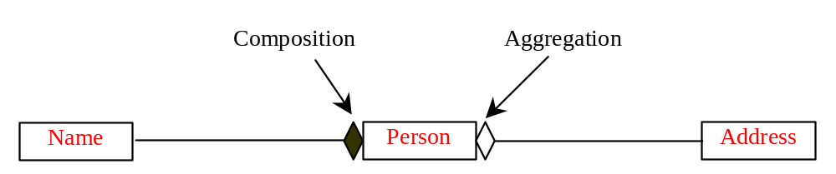
Aggregation and Composition
Aggregation is a special form of association, which represents an ownership relationship between two classes.
Aggregation models the has-a relationship.
If an object is exclusively owned by an aggregated object, the relationship between the object and its aggregated object is referred to as composition.

Slide 20
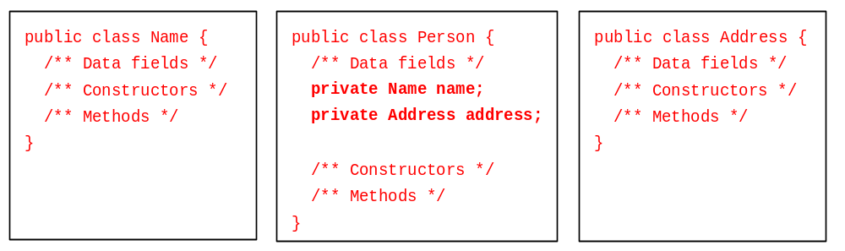
Representing Aggregation in Classes
An aggregation relationship is usually represented as a data field in the aggregated class.

Slide 21
Inner Classes Translation
If Name or Address is used in the Person class only, they can be declared as an inner class in Person. For example,
public class Person {
private Name name;
private Address address;
...
class Name {
...
}
class Address {
...
}
}

Slide 22
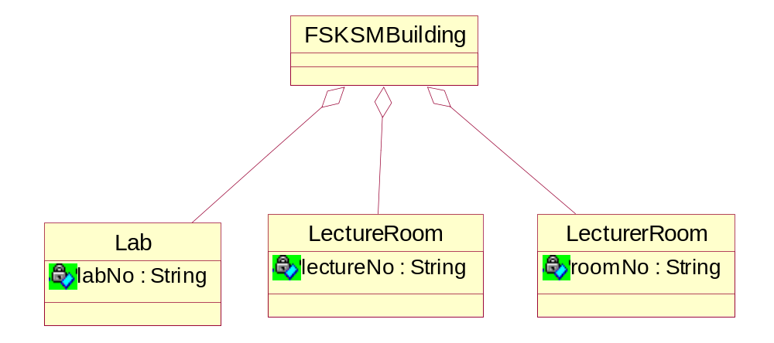
Aggregation Example 1: FSKSM building has Lab, LectureRoom and LecturerRoom
public class FSKSMBuilding
{ private Lab lab1;
private LectureRoom lect;
private LecturerRoom lectr;
}
Aggregation relationship is represented as a data field in the aggregated class.

Slide 23
Composition
Form of aggregation.
For a relationship: “contains a”.
Strong ownership / binding.
Parts belong to one whole.
Parts do not change during execution.
Automobile
public class Automobile
{
private final Transmission drive = new Transmission();
private final Motor engine = new Motor();
}
Motor
Transmission

Slide 24




Composition Example 1 – A Person has a name and an address
Person
Person(Name nama, Address add)
Name getName()
Address getAddress()
String toString()
Name
firstName : String
lastName : String
Name(String first, String last)
Address
String getFirstName()
street : String
String getLastName()
city : String
String getFullName()
state : String
zip : String
Address(String street, String city, String state, String zip)
String getStreet()
String getCity()
String getState()
String getZip()
String getFullAddress()

Slide 25
Composition Example 1 – Name class
public class Name
{ private String firstName;
private String lastName;
public Name(String firstName, String lastName)
{ this.firstName=firstName;
this.lastName=lastName;
}
public String getFullName()
{ return firstName + ' ' + lastName; } }

Slide 26
Composition Example 1 – Address class
public class Address
{ private String street; private String city;
private String state; private String zip;
public Address(String street, String city, String state, String zip)
{ this.street = street;
this.city = city;
this.state = state;
this.zip = zip; }
public String getFullAddress()
{ return street +'\n' + city+ ", " +state+ ' ' +zip ; }
}

Slide 27
Composition Example 1 – Person has a name and an address
public class Person
{ private Name name;
private Address address;
public Person(Address address)
{
name=new Name("Mohamad", "Ali");
this.address=address;
}
public Name getName()
{ return name; }
public String toString()
{ return '\n' + name.getFullName() + '\n' +address.getFullAddress() +'\n'; }
}

Slide 28
Composition Example 1 – TestPerson
public class TestPerson {
public static void main(String args[]){
Address add1 = new Address("Jalan Pulai 13/2",
"Skudai", "Johor", "81310");
Person per1 = new Person(add1);
System.out.println(per1);
}
}

Slide 29
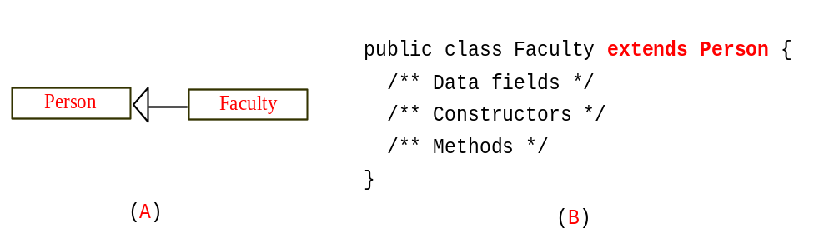
Inheritance
Inheritance models the is-an-extension-of relationship between two classes.

Slide 30
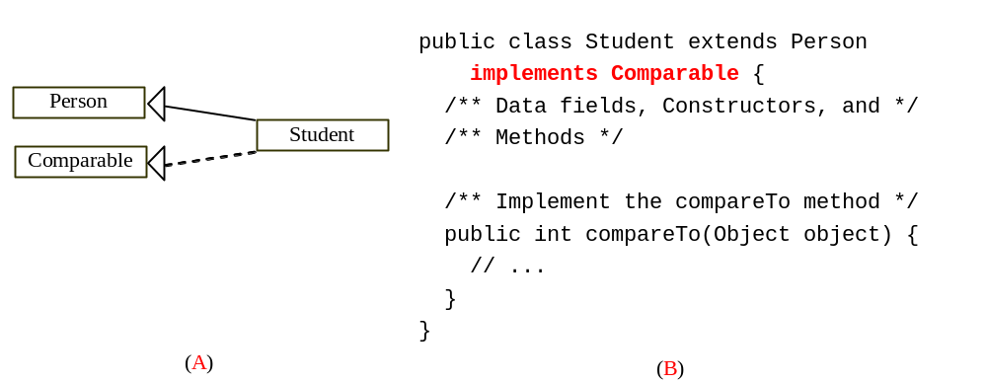
Weak Inheritance Relationship
A weak is-an-extension-of relationship can be represented using interfaces.
For example, the weak is-an-extension-of relationship “students are comparable based on their grades” can be represented by implementing the Comparable interface, as follows:

Slide 31
Self-Test
What is the appropriate relationship for the following classes:
  Company and Employee
  Faculty and Course
  Customer and Product
  Student and Matric Number
  Employee and Address
  House and Door

